Slide 1
Services, Patterns, SOLID
Vanyo Vanev
20.04.2023

Slide 2
Agenda
Implementing Services to Meet Requirements
Extracting Business Logic into a Service
Patterns for Abstraction
SOLID Principles

Slide 3
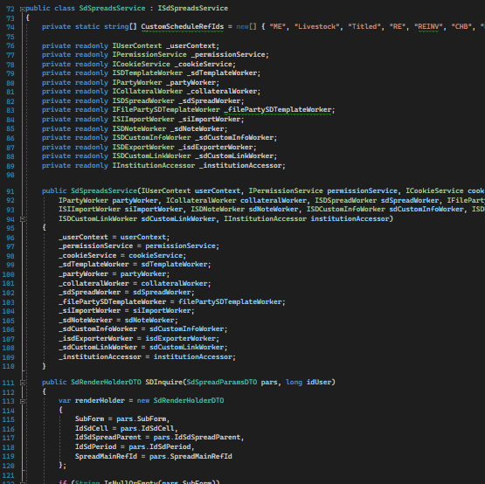
Implementing Services to Meet Requirements
Service in the context of software development
The importance of services in modern applications (e.g., modularity, maintainability, scalability)
Steps to implement services in C#
Identifying and defining requirements
Designing a service interface
Implementing service methods
Testing and validating the service

Slide 4
Extracting Business Logic into a Service
Business logic and its role in applications
Benefits of separating business logic from other layers (e.g., presentation, data access)
Extracting business logic into a service
Identify existing business logic in application
Create a new service to encapsulate the logic
Refactor the application to use the new service
Test and validate the refactored application

Slide 5
Patterns for Abstraction
Abstraction and its importance in software development
Common abstraction patterns used in C#

Slide 6
SOLID Principles
Single Responsibility Principle (SRP)
Open/Closed Principle (OCP)
Liskov Substitution Principle (LSP)
Interface Segregation Principle (ISP)
Dependency Inversion Principle (DIP)

Slide 7
Thank you

